Slide 1

Lyft 3D Object Detection for Autonomous Vehicles
TEAM V

Slide 2

Model Selection

Slide 3

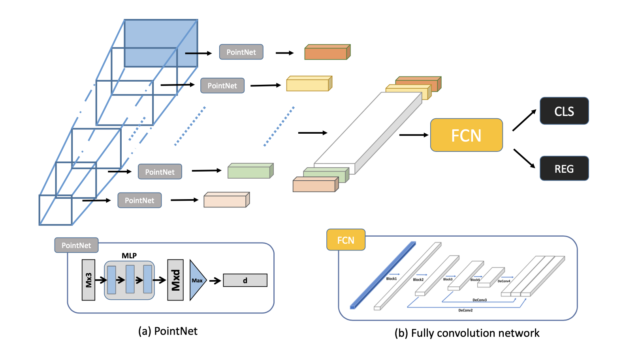
F-ConvNet (Frustum ConvNet)
Notes:
Given 2D region proposals in an RGB image, this model first generates a sequence of frustums for each region proposal, and uses the obtained frustums to group local points. F-ConvNet aggregates point-wise features as frustum-level feature vectors, and arrays these feature vectors as a feature map for use of its subsequent component of fully convolutional network (FCN), which spatially fuses frustum-level features and supports an end-to-end and continuous estimation of oriented boxes in the 3D space.
The whole framework of F-ConvNet. Grouping points and extract features by PointNet from a sequence of frustums, and for 3D box estimation, frustum-level features are re-formed as a 2D feature map for use of fully convolutional network (FCN) and detection header (CLS and REG).

Slide 4
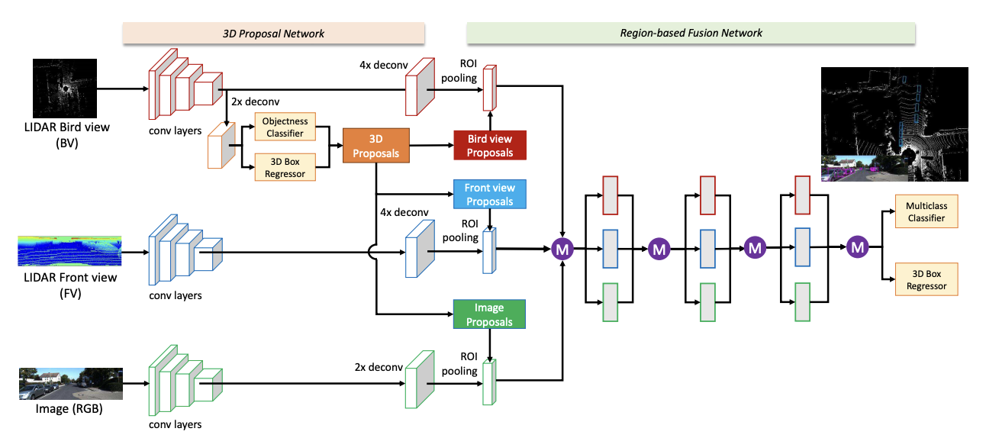
MV3D (Multi-View 3D Object Detection Network)
Notes:
Figure: Multi-View 3D object detection network (MV3D): The network takes the bird’s eye view and front view of LIDAR point cloud as well as an image as input. It first generates 3D object proposals from bird’s eye view map and project them to three views. A deep fusion network is used to combine region-wise features obtained via ROI pooling for each view. The fused features are used to jointly predict object class and do oriented 3D box regression.
A sensory-fusion framework that takes both LIDAR point cloud and RGB images as input and predicts oriented 3D bounding boxes. Encoding the sparse 3D point cloud with a compact multi-view representation. The network is composed of two subnetworks: one for 3D object proposal generation and another for multi-view feature fusion. The proposal network generates 3D candidate boxes efficiently from the bird's eye view representation of 3D point cloud. Designing a deep fusion scheme to combine region-wise features from multiple views and enable interactions between intermediate layers of different paths.

Slide 5
AVOD (Aggregate View Object Detection Network)
Notes:
The proposed neural network architecture uses LIDAR point clouds and RGB images to generate features that are shared by two subnetworks: a region proposal network (RPN) and a second stage detector network. The proposed RPN uses a novel architecture capable of performing multimodal feature fusion on high resolution feature maps to generate reliable 3D object proposals for multiple object classes in road scenes. Using these proposals, the second stage detection network performs accurate oriented 3D bounding box regression and category classification to predict the extents, orientation, and classification of objects in 3D space.
Inspired by feature pyramid networks (FPNs) [5] for 2D object detection, we propose a novel feature extractor that produces high resolution feature maps from LIDAR point clouds and RGB images, allowing for the local- ization of small classes in the scene.
• We propose a feature fusion Region Proposal Network (RPN) that utilizes multiple modalities to produce high- recall region proposals for small classes.
• We propose a novel 3D bounding box encoding that conforms to box geometric constraints, allowing for higher 3D localization accuracy. • The proposed neural network architecture exploits 1 × 1 convolutions at the RPN stage, along with a fixed look-up table of 3D anchor projections, allowing high computational speed and a low memory footprint while maintaining detection performance.

Slide 6
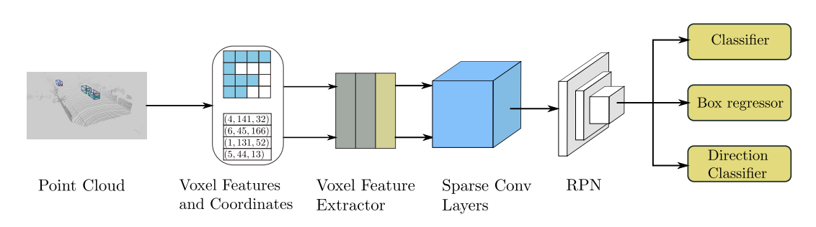
SECOND (Sparsely Embedded CONvolutional Detection)
Notes:
SECOND addresses computational cost challenges in 3D convolution-based detection by maximizing the use of the rich 3D information present in point cloud data. This method incorporates several improvements to the existing convolutional network architecture. Spatially sparse convolutional networks are introduced for LiDAR-based detection and are used to extract information from the z-axis before the 3D data are downsampled to something akin to 2D image data.
The proposed SECOND detector, depicted in Figure 1, consists of three components:
a voxelwise feature extractor;
a sparse convolutional middle layer;
and an RPN. Figure 1. The structure of our proposed SECOND detector. The detector takes a raw point cloud as input, converts it to voxel features and coordinates, and applies two VFE (voxel feature encoding) layers and a linear layer. Then, a sparse CNN is applied. Finally, an RPN generates the detection.

Slide 7
Model Comparison

Slide 8
Model | Objects | Easy | Moderate | Hard | Runtime
F-ConvNet | Car | 87.36 % | 76.39 % | 66.69 % | 470ms
 | Pedestrian | 52.16 % | 43.38 % | 38.80 %
 | Cyclist | 81.98 % | 65.07 % | 56.54 %
MV3D | Car | 74.97 % | 63.63 % | 54.00 % | 360ms
AVOD | Car | 76.39 % | 66.47 % | 60.23 % | 80ms
 | Pedestrian | 36.10 % | 27.86 % | 25.76 %
 | Cyclist | 57.19 % | 42.08 % | 38.29 %
SECOND | Car | 83.34 % | 72.55 % | 65.82 % | 38ms
 | Pedestrian | 48.96 % | 38.78 % | 34.91 %
 | Cyclist | 71.33 % | 52.08 % | 45.83 %
Note:
Results for object detection are given in terms of average precision (AP)
Results from http://www.cvlibs.net/datasets/kitti/eval_object.php
Notes:
The performance of F-ConvNet and SECOND are ranked top in these 4 models, but after a comprehensive comparison, we selected SECOND and AVOD as our model for object detection. Because the related documents of SECOND and AVOD are very detailed, we can use them directly and we can do some modifications much easier than F-ConvNet.

Slide 9

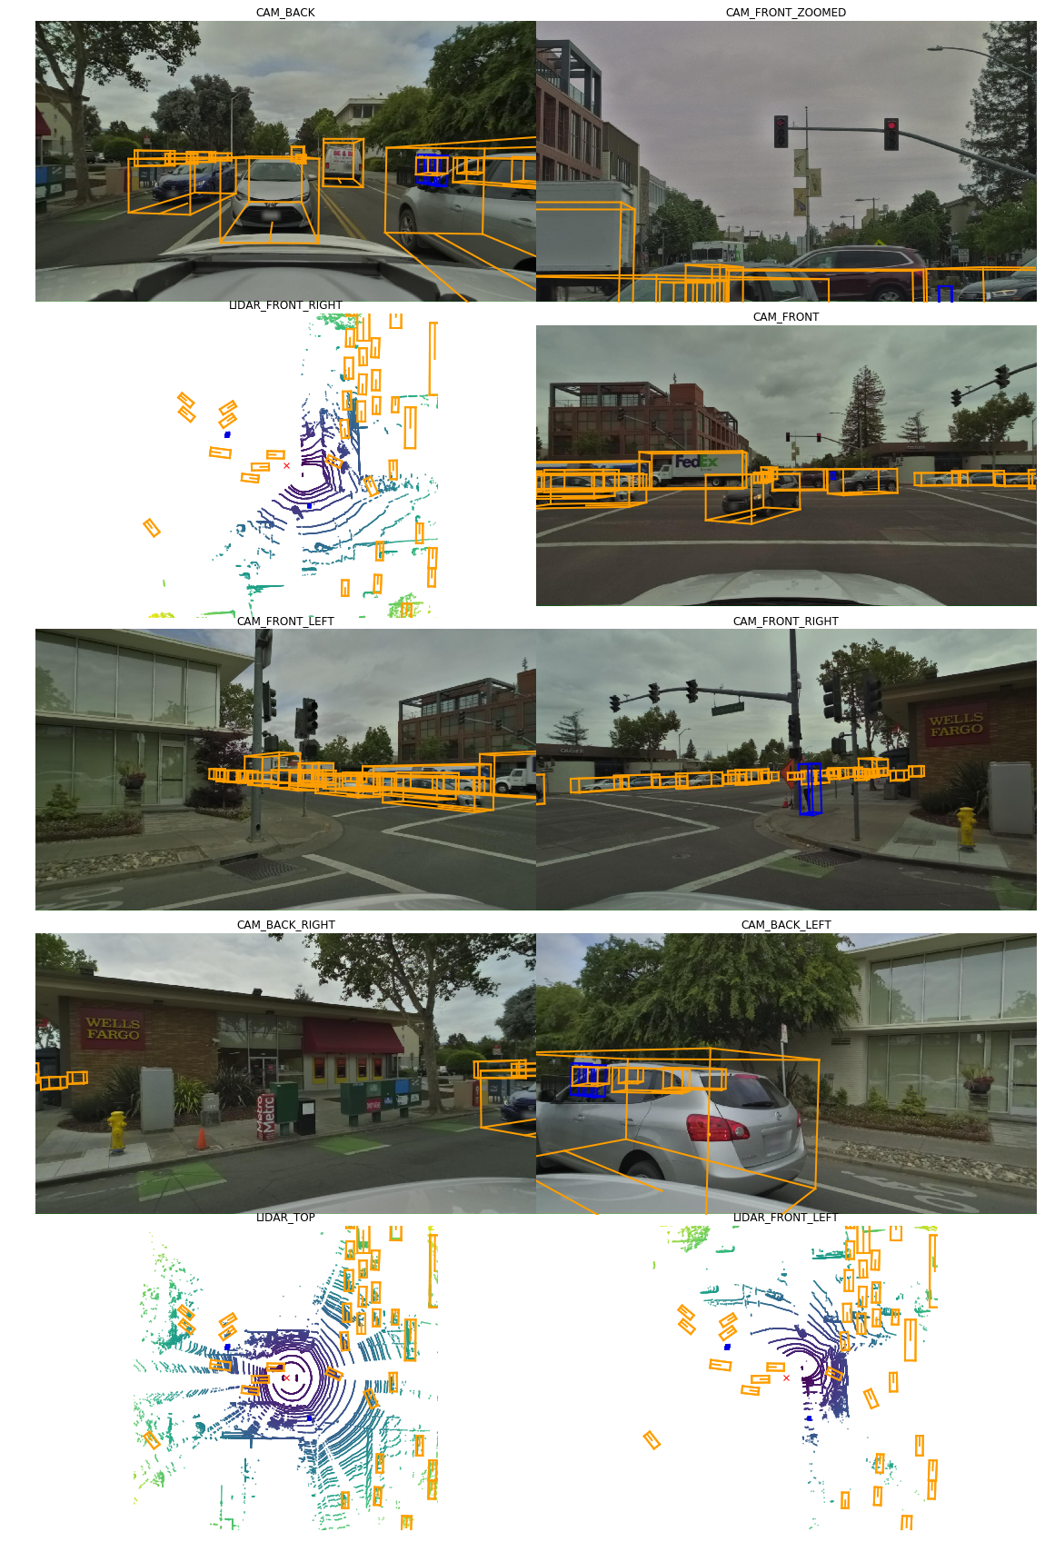
Data Visualization
- 7 cameras
- 3 lidars
Notes:
Sample of data visualization

Slide 10
Modification
Step 1 – Multi-view mixing
- Compose 7 camera images in each scene to one as input image
- Extend the input image and lidar to 7 images and 3 lidars
Step 2 – Dataset emerge
- Emerge nuScenes dataset and Lyft dataset
Step 3 – Data volume selection
- Maybe select a part of training and test data from the whole dataset (100GB) to train and test the model
Notes:
Next step
Multi-view mixing
Data volume selection

Slide 11
Multi-view mixing
- Extend input one image and lidar to 7 images and 3 lidars
…
Notes:
Next step
Multi-view mixing
Data volume selection

Slide 12
Multi-view mixing
- Compose 7 camera images in each scene to one as input image
360 degree panorama
…
Notes:
Next step
Multi-view mixing
Data volume selection

